Slide 1


Social Buzz – Data Analysis

Slide 2


Today's agenda
Project recap
Problem
The Analytics team
Process
Insights
Summary

Slide 3

We at Accenture are undergoing a data analysis process to find important insights on how to grow Social Buzz as a company and make it outgrow its competition.
We with the data we have will determine whether Social Buzz is ready to make an IPO, determine its top 5 content categories and see what other insights about the company we can get from the data we have been given.
Project Recap

Slide 4

Problem
Social Buzz has company data that has not been cleaned and organised and as a result the necessary insights needed to drive decision making have not been discovered.

Slide 5



Chief Technical Architect
Data Scientist
Data Analyst
The Analytics team

Slide 6
Looked at the company operational data, company hierarchy and entity relationships within the data model provided.
Process
1
2
Data wrangling and cleaning stage.
Data modelling and merging, creating synergies and removing duplicates.
3
We analysed the data and provided insights via graphs.
4
Recommendations for Social Buzz.
5

Slide 7
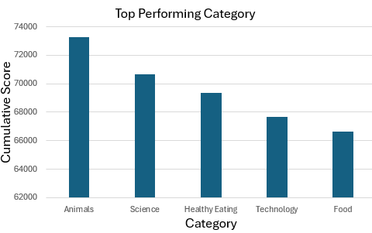
Insights

Slide 8
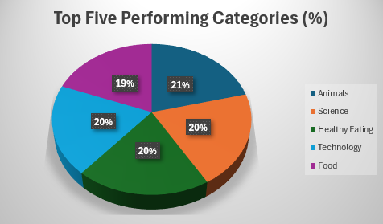

Slide 9
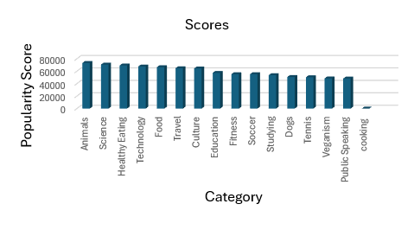

Slide 10


1.According to the Social Buzz’s consumer behaviour insights the Animal category has the highest popularity score and engagements and as a result it would make business sense for Social Buzz to implement the 80/20 rule as most of their profits are and will always come from the top 5 category.
2.This should consist of the majority of the content they produce on their platform for their customers.
It may also be beneficial from Social Buzz to divest resources in making cooking content and perhaps open up a survey for recommendations on what their customers would like to see introduced on their platform.
Summary and Recommendations

Slide 11
Thank you!
ANY QUESTIONS?

